Slide 1
Drivers-Alert-
Safety-Monitoring-
System

Slide 2
Distracted Driving PoC Overview
OBJECTIVE
To find the emotion of driver while driving the vehicle.
Emotions like Drowsiness, Fatigue and Distraction can be detected from internal camera.
KEY DELIVERABLES
Identify the face of driver for a given video.
From the face, identify whether the driver is distracted (drowsy, fatigue, distracted – looking away from center of road)
Algorithm/Code to classify the emotions (Drowsiness, Fatigue, and Distraction) of driver
EXPECTED BENEFITS
Zero dependency on third parties for classify emotion of driver
Understand the impact of drowsiness detection for driver safety, to identifying whether driver is attentive or distracted while driving, and to build a highly personalized and intimate in-cab experience
The aim of emotion recognition should be to support the driver in performing steering, accelerating, braking, and choosing the correct lane, speed, route, and distance to other vehicles.
Target Customers: OEMs, Tier 1s, Insurance, Shared Mobility / Fleet

Slide 3
Process
Input Video
Convert into number of frames
Find the face from the frame using dlib's face detector (HOG-based).
Logic for
Drowsiness, Fatigue, Distraction for each frame
Create a single output video with alert message.

Slide 4
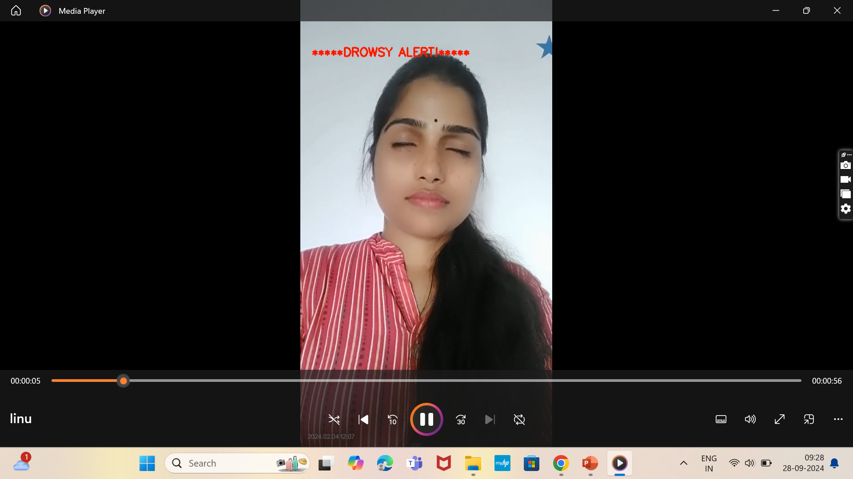
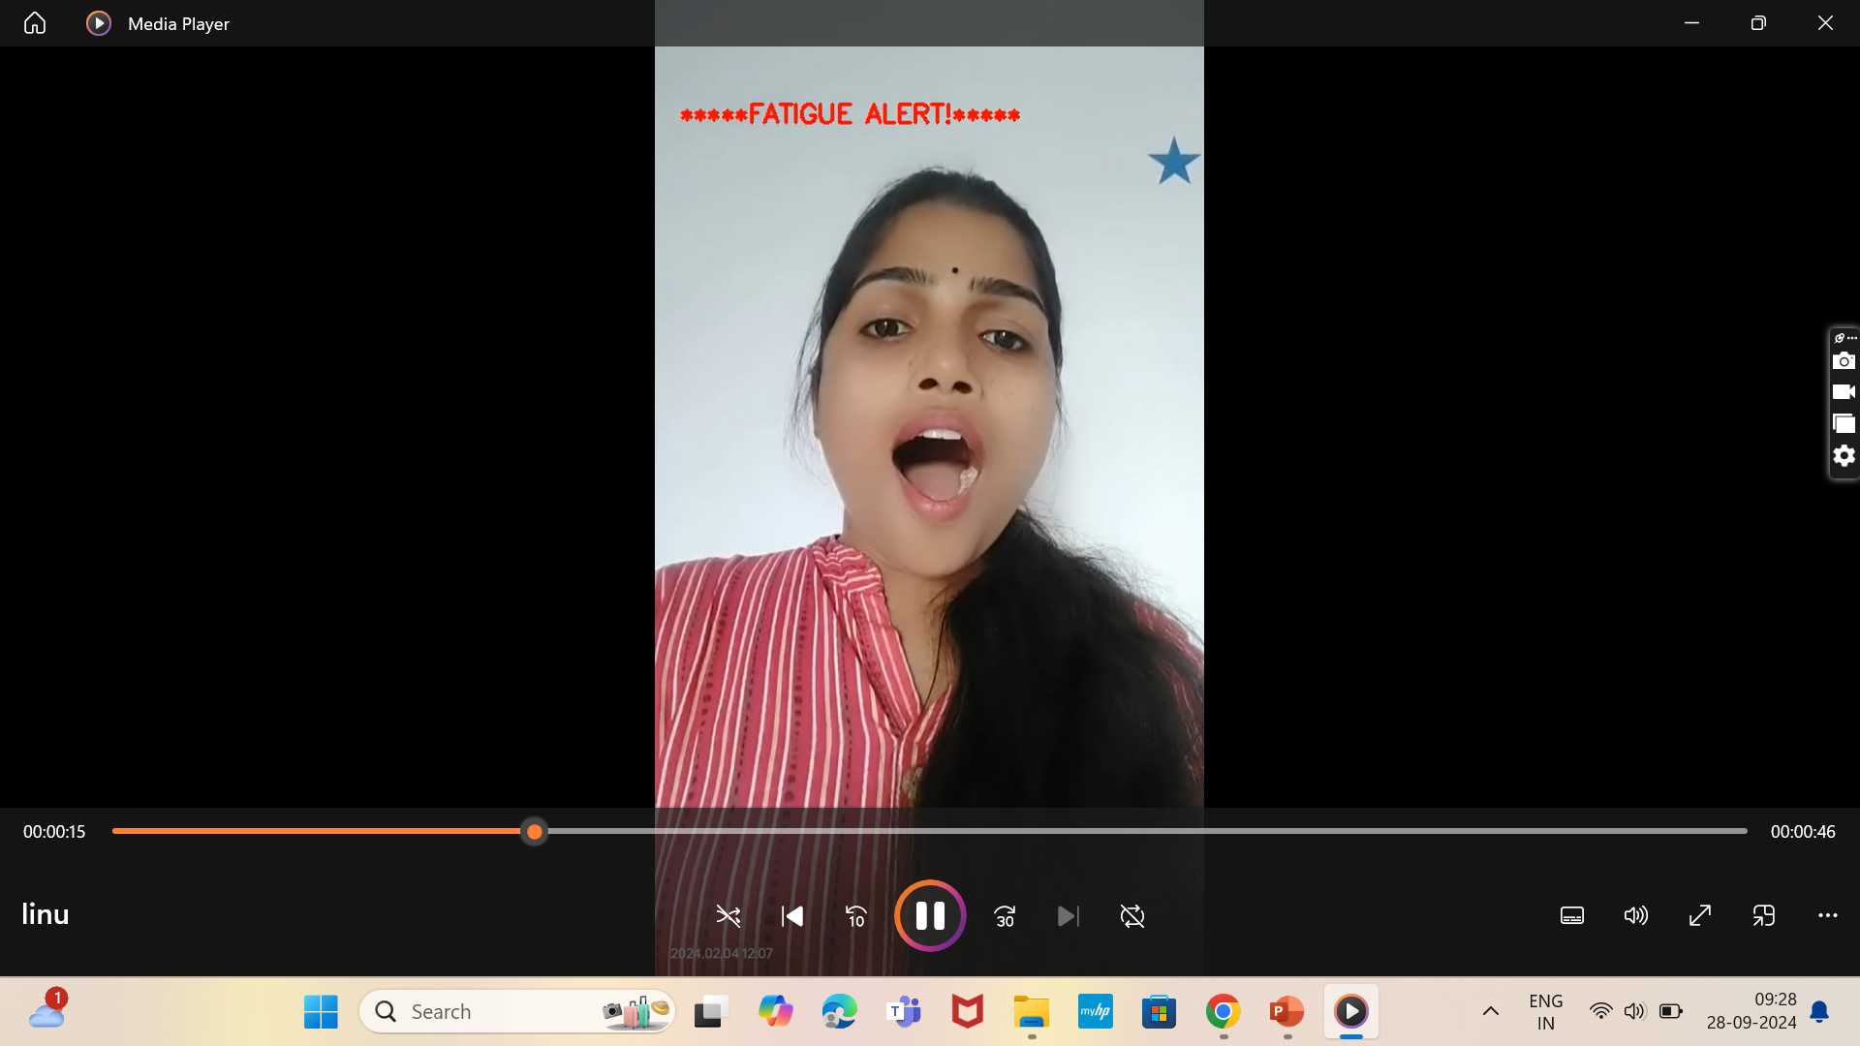
Deliverables/Output:
Different emotions are given below. Screenshot are taken from the output video.

